Slide 1
Introduction to NLP Linguistic Concepts
Dr. Paul Buitelaar
Data Science Institute, University of Galway
Includes updates by Omnia Zayed

Slide 2
Learning Objectives
Understand the link between NLP and Linguistics
Understand different levels of linguistic analysis
Digging deeper into linguistic analysis in NLP
Understand basic linguistic concepts used in NLP
Insight into language data

Slide 3
Interdisciplinary field
Linguistics
Computer Science
NLP
Statistics
Artificial Intelligence

Slide 4
Linguistics and NLP
Linguistics
Linguistic study develops a theory that explains
use of language - ‘language performance’
knowledge and acquisition of language - ‘language competence’
NLP is concerned with
use of language - data
knowledge and acquisition of language - models
NLP

Slide 5
Linguistic Levels of Analysis
Phonology – acoustic signal
Morphology – word structure
Syntax – sentence and phrase structure
Semantics – meaning and reference
Discourse – relations between sentences
Pragmatics – communication
Sound
Structure
Meaning

Slide 6
Linguistic Levels of Analysis
S
NP
VP
VP
SYNTAX
NP
PART OF SPEECH
PRP
VBP
VBG
DET
NN
NN
I am enjoying the NLP course
WORDS
person: 1st
number: singular
case: nominative
person: 1st
number: singular
tense: present
mood: indicative
tense: present
number: singular
case: proper
number: singular
MORPHOLOGY
NLP¹: [abbreviation] natural language processing
COURSE¹: a series of lessons or lectures on a particular subject
SEMANTICS

Slide 7
Morphology & Tokenization

Slide 8

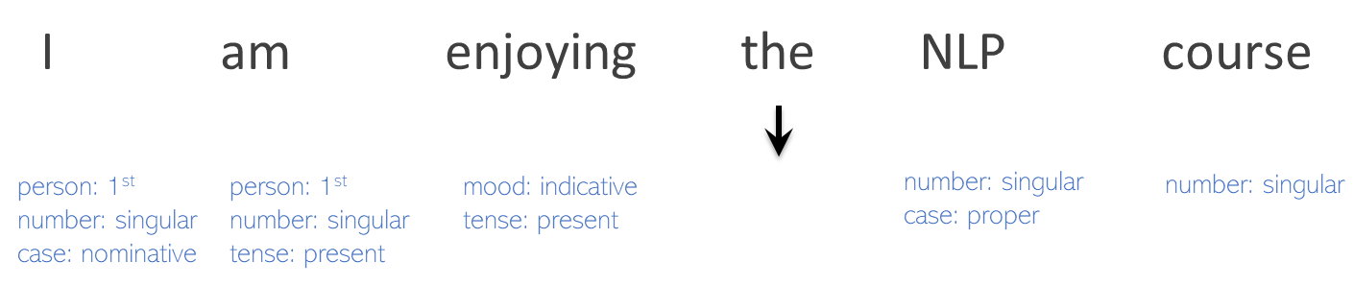
Morphology & Tokenization
Linguistics
We want to study the internal structure of words
NLP
We want to convert the text into a more convenient, standard form.
Let us look at:
Tokenization: types vs. tokens
Morphology: stemming vs. lemmatization
Morphology: inflection & derivation

Slide 9
Tokenization
Tokenization (in NLP) is the process of dividing a piece of text into smaller units i.e. tokens.
The number of tokens is the total occurrence of individual words
The number of types is the total occurrence of unique words
For example, in the sentence ‘the cat sat on the mat’ there are:
6 tokens the, cat, sat, on, the, mat
5 types the, cat, sat, on, mat

Slide 10
Buzz Groups
Can you think of any challenges in tokenization

Slide 11
Tokenization - Challenges
Multi-word expressions (MWEs)
For example, technical terms such as in the health domain
cardiac arrest
or names of people, locations, organisations, etc.
Barack Obama
San Francisco
United Nations

Slide 12
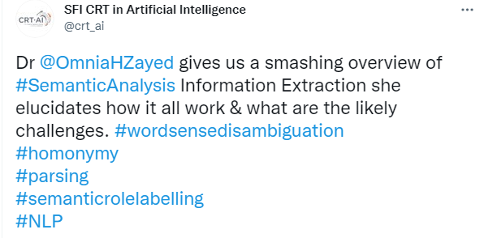

Tokenization - Challenges
Non-linguistic tokens which are used in tweets e.g. hashtags, mentions, emoticons.

Slide 13
Tokenization - Challenges
Compounds and Decomposition
Compound: concatenation of simple words into a complex word
(note that analysis of compounds is referred to as decomposition)
Compounds are not common in English, but for example:
Bookshelves > book + shelves
bedroom > bed + room
policeman > police + man

Slide 14
Tokenization - Challenges
Compounds (morphological decomposition) are very common in German
Flachbildschirm > flach + Bildschirm (flat + screen)
Flachbildschirm > Flachbild + Schirm (flat view + screen)
Flachbildschirm > flach + Bild + Schirm (flat + picture + screen)
also very common in Dutch
bestuurdersaansprakelijkheidsverzekering (driver + liability + insurance)
overeenstemmingsbeoordelingsprocedures (conformity + assessment + procedures)
and in many other languages
https://en.wikipedia.org/wiki/Longest_words

Slide 15
Morphology
How do we treat the words in a sentence?
We look at lemmatization and stemming.
Lemmatization: obtaining the root of the word
Stemming: obtaining a stem of a word (could be seen as a simpler (non-linguistic) version of lemmatization)
Notes:
Let us look at the words themselves

Slide 16
Morphology – Lemmatization
Linguistic analysis of word structure by a transformation of morphologically related words to a common lemma
For example:
studies ies > y study
studying ing > - study
studied ied > y study
teaches es > - teach
teaching ing > - teach
taught > teach

Slide 17
Morphology – Stemming
Non-linguistic (simplified) analysis of word structure by removing endings/beginnings of words - leaving a common stem
For example:
learns > learn-s
learning > learn-ing
learned > learn-ed
Problematic for instance for irregular verbs
For example:
teaches > teach-es
teaching > teach-ing
taught > ??

Slide 18
Morphology
How do we analyse the grammar of the words in a sentence?
We look at inflection and decomposition.
Inflection: grammatical role and structure of words
Derivation: generation of words from other words

Slide 19
Morphology – Inflection
Linguistic analysis of internal structure of words into
lemma with inflectional features
For example:
writes write + Verb + 3rd Person + Singular + Present
wrote write + Verb + 3rd Person + Singular + Past
writing write + Verb + Progressive

Slide 20
Morphology – Inflection
Inflectional patterns can be shared across word classes
For example, many English verbs share this pattern:
write s Verb + 3rd Person + Singular + Present
read s Verb + 3rd Person + Singular + Present
work s Verb + 3rd Person + Singular + Present

Slide 21
Morphology – Inflection
But note that there are many irregular inflectional patterns
For example:
wr o te Verb + 3rd Person + Singular + Past
read Verb + 3rd Person + Singular + Past
work ed Verb + 3rd Person + Singular + Past

Slide 22
Morphology – Inflection
Also note ambiguity between syntactic classes (‘part of speech’)
For example, identical but ambiguous inflection of nouns and verbs:
book s Verb + 3rd Person + Singular + Present
book s Noun + Plural

Slide 23
Morphology – Derivation
Linguistic analysis of internal structure of words into
root word + derivational affix (suffix/infix/prefix)
For example:
agreement noun - derived from - verb agree + ment
friendship noun - derived from - noun friend + ship
civilize noun - derived from - adjective civil + ize
civilization adjective - derived from - verb civilize + (e>a)tion

Slide 24
Buzz Groups
Can you do a morphological analysis of this sentence:
Barack Obama’s bookshelves had books about ancient civilizations

Slide 25
Morphology
Morphological and MWE analysis affects the nature and number of types and tokens in the text through inflection, derivation, decomposition
For example:
Barack Obama’s bookshelves had books about ancient civilizations
can be analyzed as:
Barack_Obama book shelf have book about ancient civil|civilize|civilization

Slide 26
Syntax

Slide 27
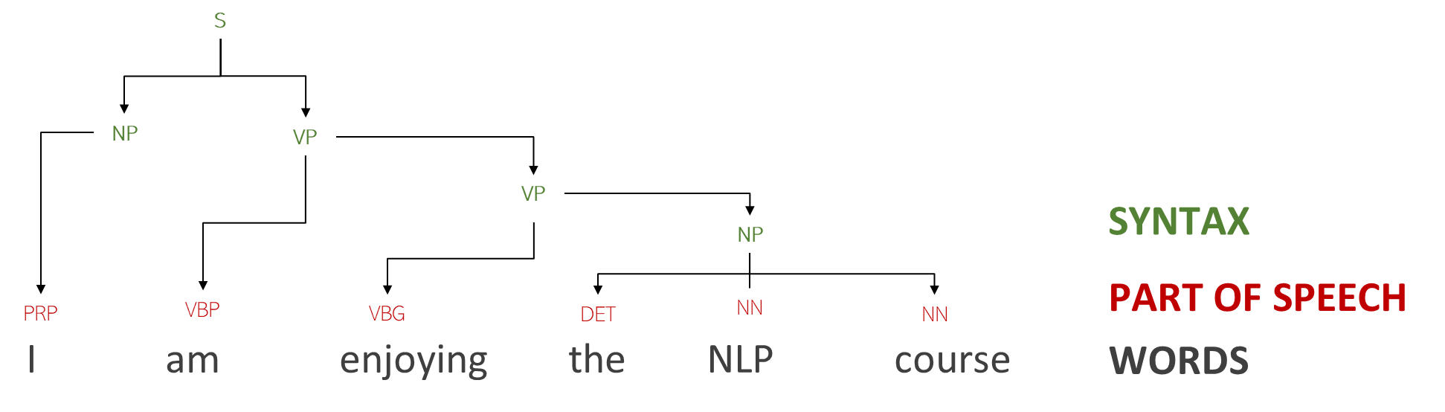
Syntax
The study of the structure of sentences/phrases and how words modify one another.
We want to understand how sentences are formed from words in a certain language
What can help us:
Part of Speech (PoS)
Phrase Structure
Grammatical Relations

Slide 28
Syntax – Part of Speech (PoS)
PoS tag: syntactic category of a word (noun, verb, etc.)
Why do we need it?
Useful in semantic analysis:
Useful for many NLP applications, e.g., PoS can be used as a feature in text classification, authorship identification, etc.
They can fish
modal_verb
They can fish
verb
can: ‘are able to’
can: ‘put into cans’

Slide 29
Syntax – PoS Tagset
Tagset: standardized codes for fine-grained part of speech analysis
Traditionally, there are 9 parts of speech in English
noun, verb, article, adjective, preposition, pronoun, adverb, conjunction, interjection
But there are more categories and subcategories for each
Examples of the most popular tagsets for English:
Penn Treebank PoS: 36 tags
CLAWS TAGSET C8: over 140 tags
http://ucrel.lancs.ac.uk/claws8tags.pdf
https://www.ling.upenn.edu/courses/Fall_2003/ling001/penn_treebank_pos.html

Slide 30
Syntax – PoS Tagset Penn Treebank for English
Nouns Singular NN dog, fork
Plural NNS dogs, forks
Proper noun - singular, plural NNP, NNPS John, Smiths,…
Personal pronoun PRP I, you, he, she, it
Wh-pronoun WP who, what,…
Verbs Base, infinitive VB eat
Past tense VBD ate
Gerund VBG eating
Past participle VBN eaten
Non 3rd person singular present tense VBP eat
3rd person singular present tense VBZ eats
Modal MD should, can
To Particle TO to eat
Adjectives Basic JJ red, tall
Comparative JJR redder, taller
Superlative JJS reddest, tallest
Adverbs Basic RB quickly
Comparative RBR quicker
Superlative RBS quickest
Prepositions Preposition IN on, in, by, to, with,…
Determiners Basic determiner DT a, an, the
WH-determiner WDT which, that,…
Conjunctions Coordinating Conjunction CC and, but, or
Particles Particle RP off (took off), up (put up),…
https://www.ling.upenn.edu/courses/Fall_2003/ling001/penn_treebank_pos.html

Slide 31
Syntax – Parsing
How can we analyse the grammar of a sentence?
We look at parsing to extract syntactic information.
Constituency and dependency parsing are two methods of parsing that use different types of grammars.
Since they are based on totally different assumptions, the resulting output will be very different.

Slide 32
Syntax – Parsing
Parsing refers to the task of creating a parse tree from a given sentence.
Parse tree highlights syntactic structure according to a formal grammar.
Parse tree will have different features depending on type of grammar:
by exposing the syntactic relationships between words – Dependency
by exposing the syntactic relationships between phrases – Constituency

Slide 33
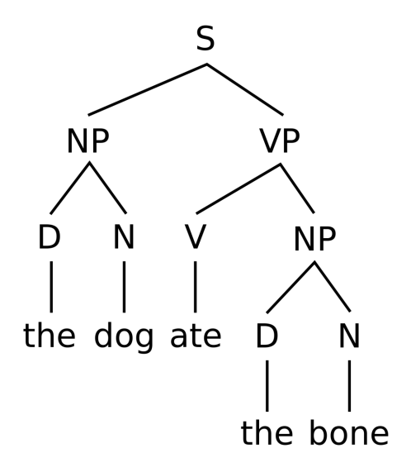
Syntax – Constituency Parsing
Groups of words that function as identifiable ’constituents’ or ‘phrases’
Phrase structure analysis is called Constituency Parsing, using context-free grammars
Why do we need it?
as a step towards assigning semantics
useful for other NLP applications e.g. features for classification
the dog, the bone Noun Phrase (NP)
ate the bone Verb Phrase (VP)
https://en.wikipedia.org/wiki/Phrase

Slide 34
Syntax – Phrase Structure Grammar
A (context-free) Phrase Structure Grammar G=(N,Σ,P,S) consists of:
a set of non-terminal symbols N, e.g.
N, V, NP, VP, S
a set of terminal symbols Σ, e.g. (the words)
astronomer, cat, see, the
a set of rules i.e. productions P, e.g.
S → NP VP
V → see
N → astronomer
a start symbol, normally 'S'
Productions
the LHS (parent) is a single non-terminal and the RHS is a sequence of one or more non-terminal or terminal symbols (children)

Slide 35
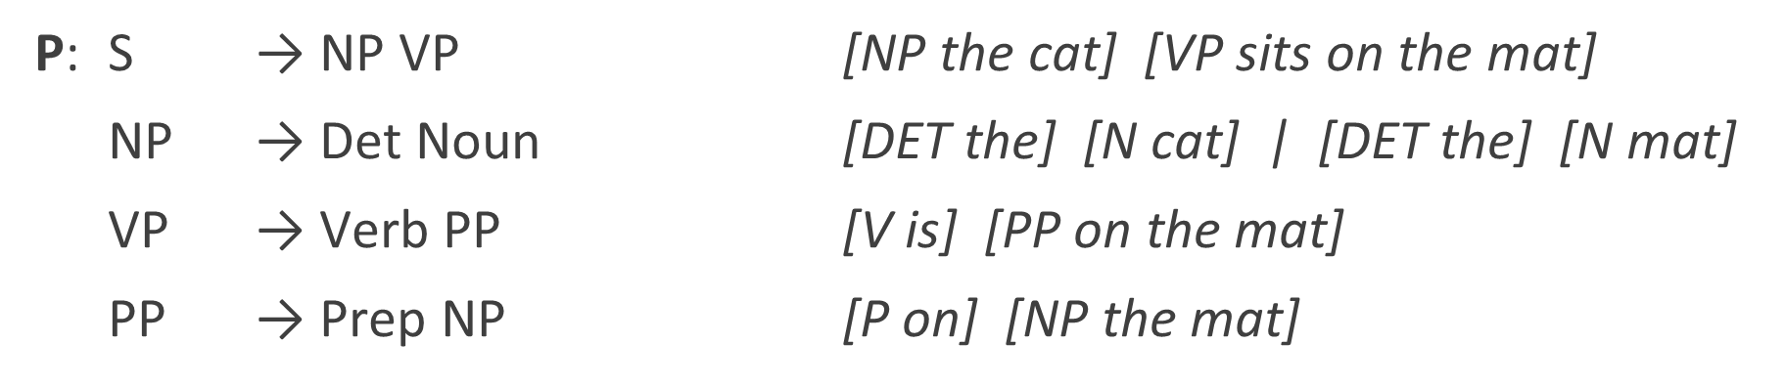
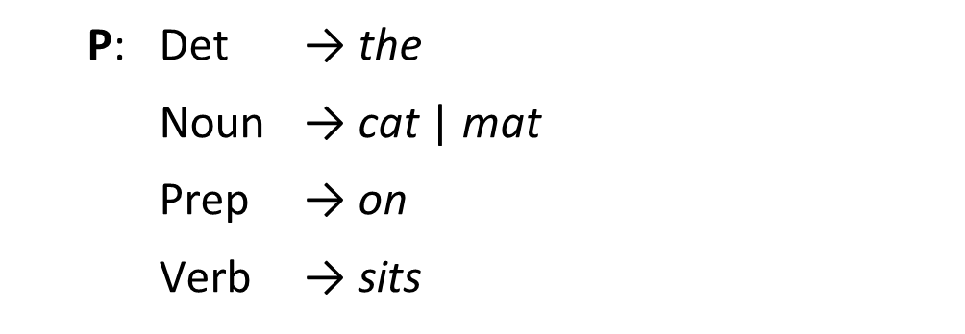
Syntax – Phrase Structure Grammar – Example
The cat sits on the mat
G=(N,Σ,P,S)
N: Det, Noun, Prep, Verb, NP, PP, VP, S
Σ: cat, mat, on, sits, the
S
Grammar Rules (grammar)
Lexical Rules (lexicon)

Slide 36
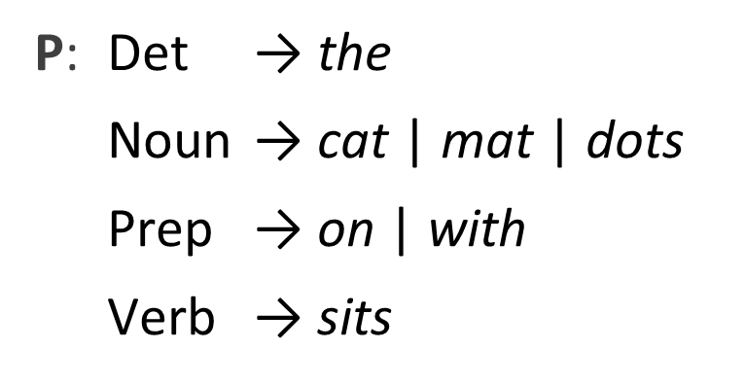

Phrase Structure Grammar – Recursion
The cat sits on the mat with the dots
G=(N,Σ,P,S)
N: Det, Noun, Prep, Verb, NP, PP, VP, S
Σ: cat, dots, mat, on, sits, the, with
S
Grammar Rules (grammar)
Lexical Rules (lexicon)
Recursion

Slide 37
Syntax – Parsing
Remember
We are analysing the syntactic structure of a sentence
We first identified the PoS tags of each word in a sentence
We then looked at constituency parsing to understand the structure of groups of words (phrases)

Slide 38
Syntax – Dependency Parsing
Dependency parsing analyzes the dependency structure of a sentence by use of a set of grammatical relations that can be identified between words
A grammatical (dependency relation) consists of:
a head word (H)
a dependent word (D)
a label identifying the relation between H and D
Why do we need it?
Dependency relations provide an interface to semantics
Useful for NLP tasks such as Information Extraction or Question Answering.
John hit the ball
(H=hit, D=John, SUBJ)
(H=hit, D=ball, OBJ)
(H=ball, D=the, DET)

Slide 39
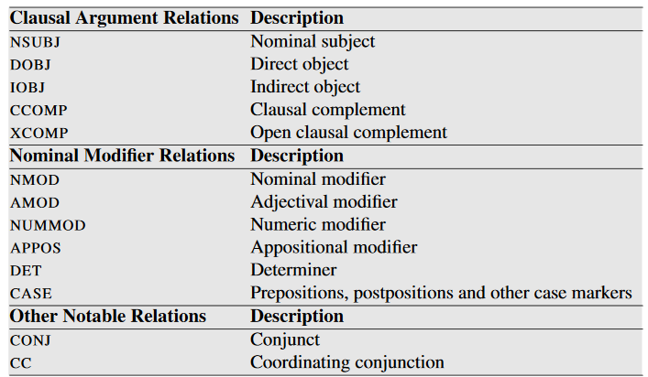
Syntax – Dependency Relations
Most commonly used are Universal Dependency relations
Selected dependency relations from the Universal Dependency set
https://universaldependencies.org/ see also SLP3 chapter 14: Dependency Parsing, page 282

Slide 40
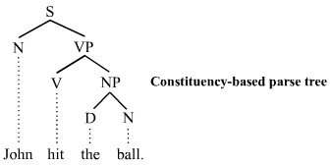
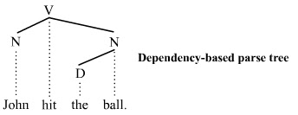
Syntax – Constituency vs Dependency Parsing
Looks at the grammatical structure of / relation between word groups (phrases) within a sentence
Makes use of phrasal constituents or sub-phrases
Looks at grammatical relations between words
Does not use phrasal constituents or sub-phrases

Slide 41
Buzz Groups
What could be a challenge in syntactic parsing?

Slide 42
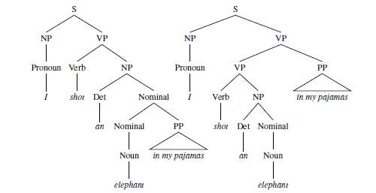
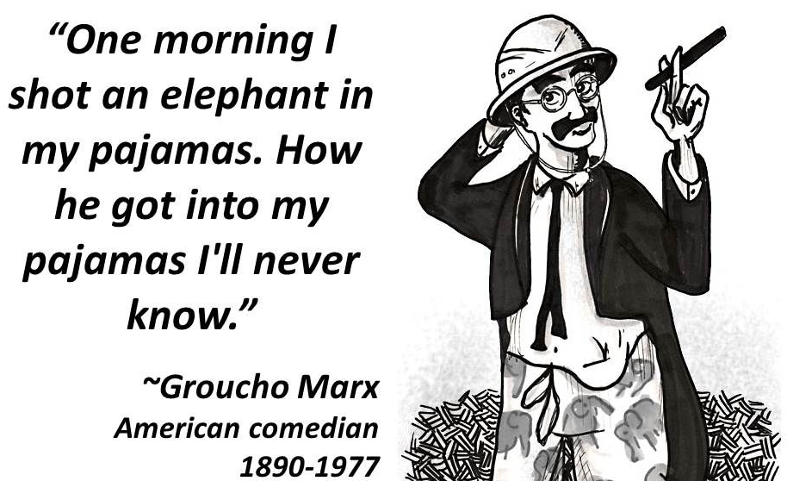
Syntax – Ambiguity
Common problem in syntactic parsing - know as ‘PP Attachment’

Slide 43
Semantics

Slide 44
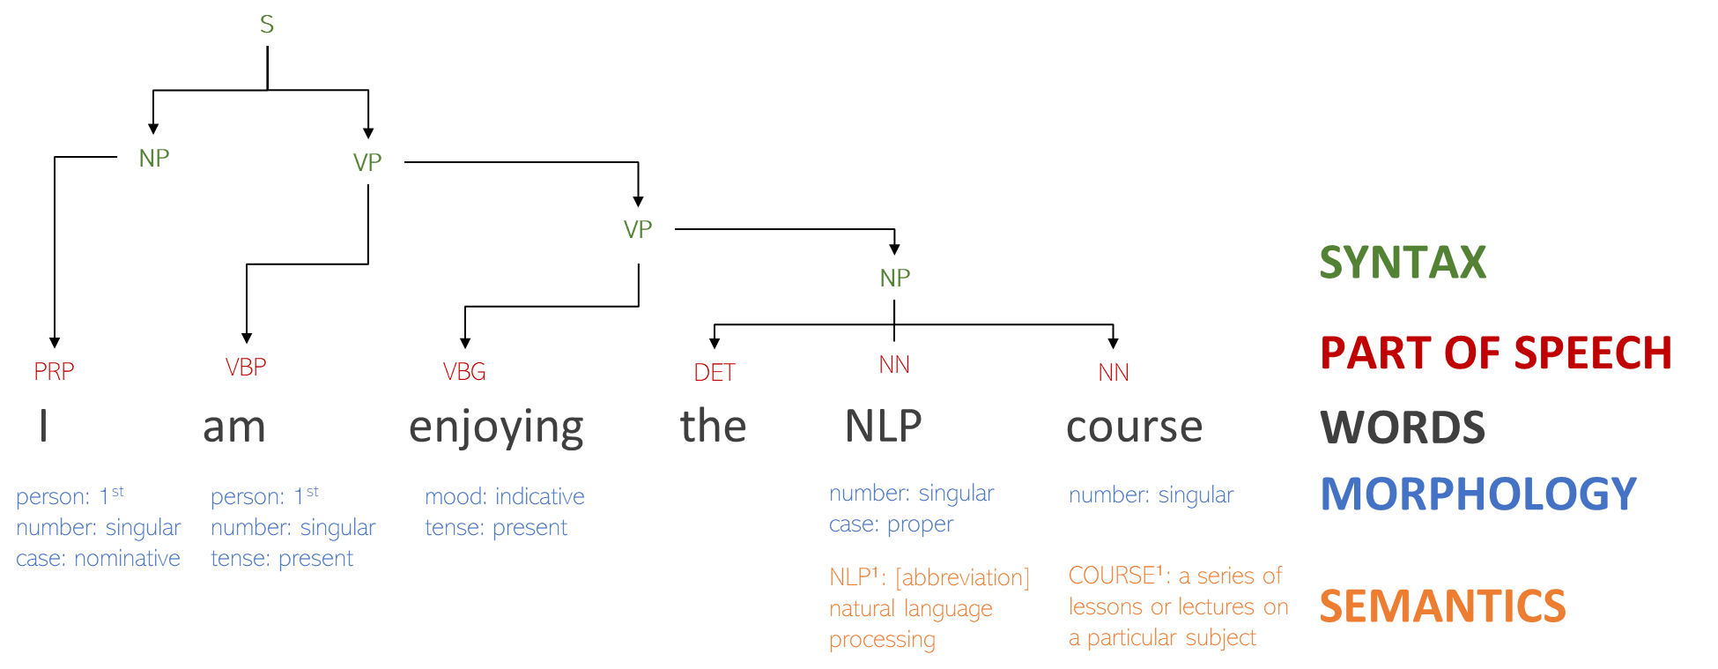
What have we seen so far?

Slide 45
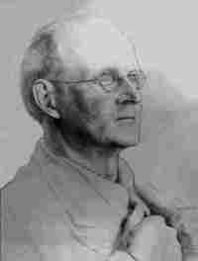
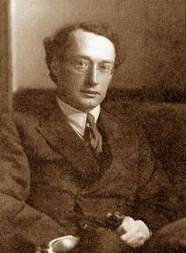
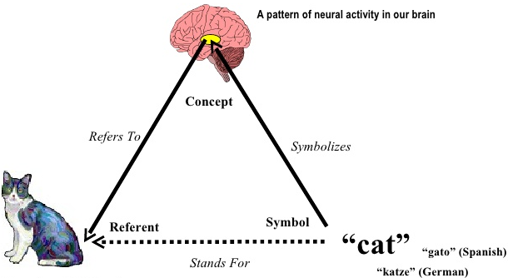
Semantics
The study of meaning (interpretation) and reference
Foundations
Semiotics or Semiology: the study of signs, symbols and their reference
Semiotic Triangle is interface between:
C. K. Ogden
I. A. Richards
objects in the world (referents)
cognitive interpretation of these objects (concepts)
symbolic representations for these cognitive interpretations (symbols)
C. K. Ogden and I. A. Richards, The Meaning of Meaning: A Study of the Influence of Language upon Thought and of the Science of Symbolism (1923)

Slide 46
Semantics
Semantic analysis of language data is concerned with
how linguistic symbols (words, phrases, sentences)
refer to concepts (entities, relations, events)
about referents (objects in the world)
Relation between linguistic symbols and concepts commonly referred to as ‘meaning’

Slide 47
Semantics – Levels of Semantic Analysis
Lexical Semantics
meaning of a word (table, large, to book, in, ...)
Compositional Semantics
combined meaning of several words in a phrase (large table, book a table) or sentence (He booked a large table.)
Discourse Semantics
combined meaning of several sentences (He booked a table. It was still available.)
Note: also in dialog (‘turns’ in chatbots and other dialog systems)

Slide 48

Semantics – in NLP
What do we want the computer to do?
understand natural language data (text) based on meaning and context

Slide 49

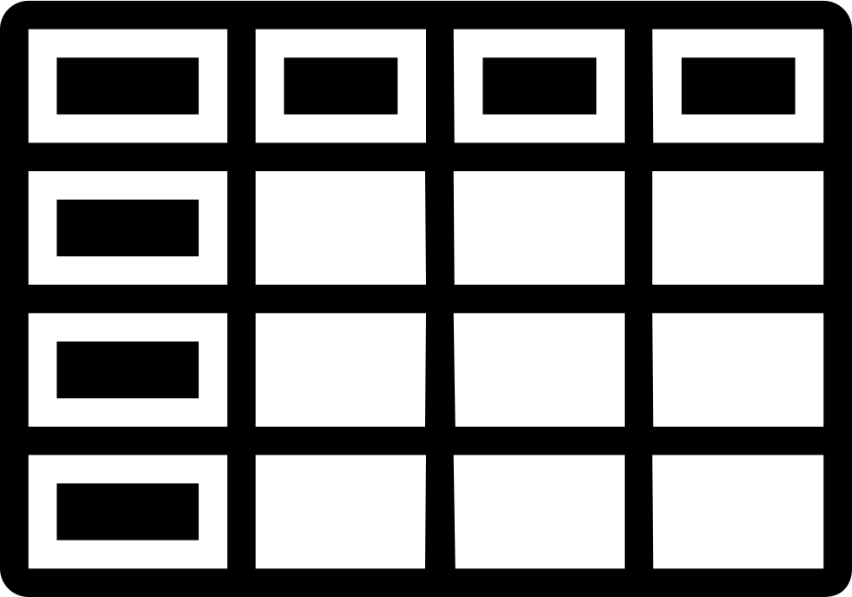
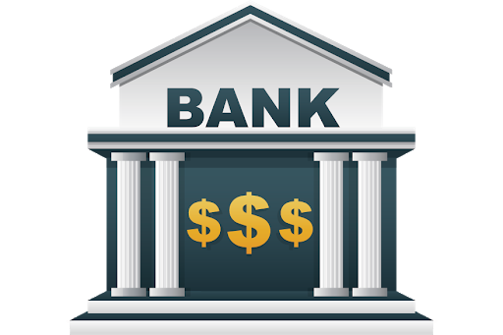



Semantics – Where is the challenge?
Lexical Semantic Ambiguity
which word(s) refer to which concept(s)?

Slide 50
Semantic Analysis Tasks in NLP
Word Sense Disambiguation
identify intended meaning (‘sense’) of a word in a specific linguistic context
Semantic Role Labeling
identify implied semantic role of an entity expressed by a word or phrase
[Kristina AGENT] hit [Scott EXPERIENCER] [with a baseball INSTRUMENT] .
Coreference Resolution
identify which words or phrases refer to the same entity
Obama nominated Clinton as his secretary of state.

Slide 51
Language Data

Slide 52
Buzz Groups
Can you name some types of language data?

Slide 53




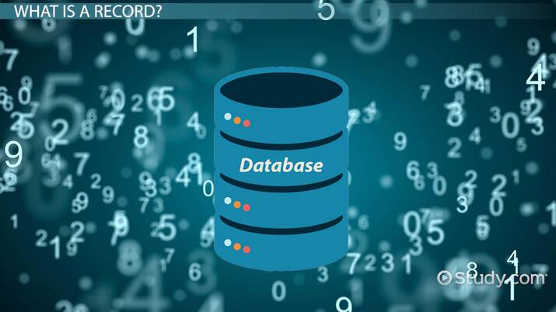


Language Data – Types
Images courtesy: https://media.gcflearnfree.org/content/59568c218444e80fc02ecc5d_06_30_2017/businessreport_illustration.jpg
https://cdn.relevance.com/wp-content/uploads/2020/04/Social-Media-Marketing-Software.jpg
https://www.engagebay.com/blog/wp-content/uploads/2019/07/html-or-plain-text-emails.png ; https://media.istockphoto.com/videos/newspaper-headline-breaking-news-video-id187763065?s=640x640
https://study.com/cimages/videopreview/videopreview-full/dl4oegfq0k.jpg ; https://www.thestatesman.com/wp-content/uploads/2021/01/iStock-458651827.jpg
Notes:
What else?

Slide 54
Language Data – Some Specifics by Type
Language Data | Specifics
formal reports | complete grammatical sentences
slides | (in)complete (un)grammatical sentences and phrases
text fields in DBs | (in)complete (un)grammatical sentences and phrases database structure
emails | (in)complete (un)grammatical sentences and phrases threads with temporal and social network structure
social media | (in)complete (un)grammatical sentences, phrases threads with temporal and social network structure multimedia data
… | …

Slide 55
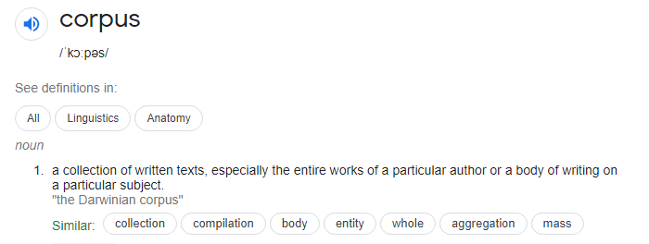
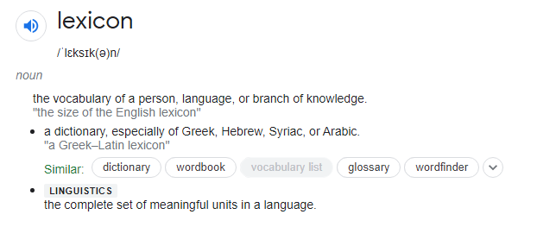
Language Data
Corpus: Collection of texts
Lexicon: Collection of words (vocabulary)

Slide 56
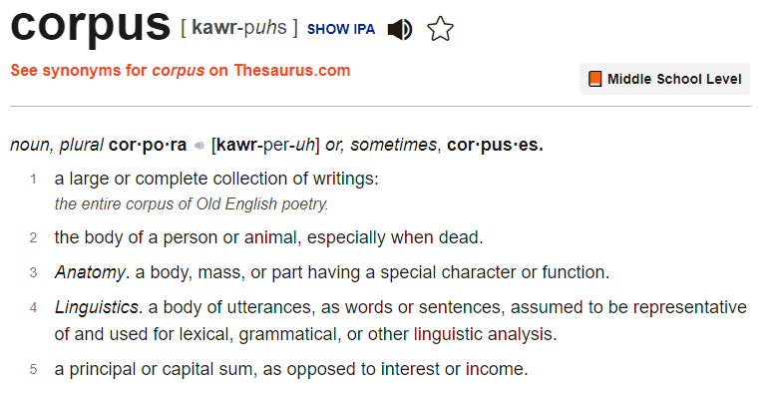
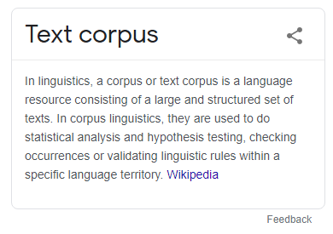
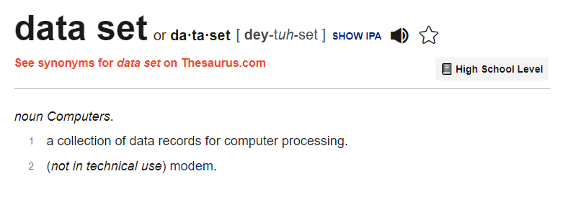
Language Data - Corpus
Please note
Corpus (singular)
Corpora (plural)
In NLP, we also use dataset

Slide 57
Corpus Annotation
In order to teach the computer to model (‘understand’) how a language works:
we need realistic samples of a language
of particular interest to NLP are corpora with (linguistic) annotations
What’s the correct part of speech tag?
syntactic structure?
sentiment?
…

Slide 58
Types of Corpus Annotation
Annotation | Specifics
part-of-speech | annotation of words with ‘PoS tags’ (N, V, Adj, Prep,...)
word sense | annotation of words with their ‘sense’ (bank_01, bank_02,...)
semantic role | annotation of words with their ‘semantic role’ (Agent, Recipient, Instrument,...)
entity type | annotation of words with a type of ‘entity’ (Person, Location, Organization,…)
translation | words in a ‘corpus’ in language A aligned to words in a ‘corpus’ in language B
… | …

Slide 59
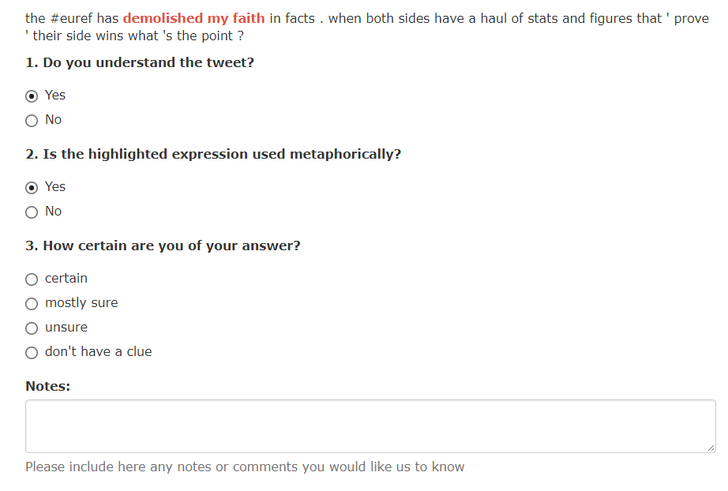
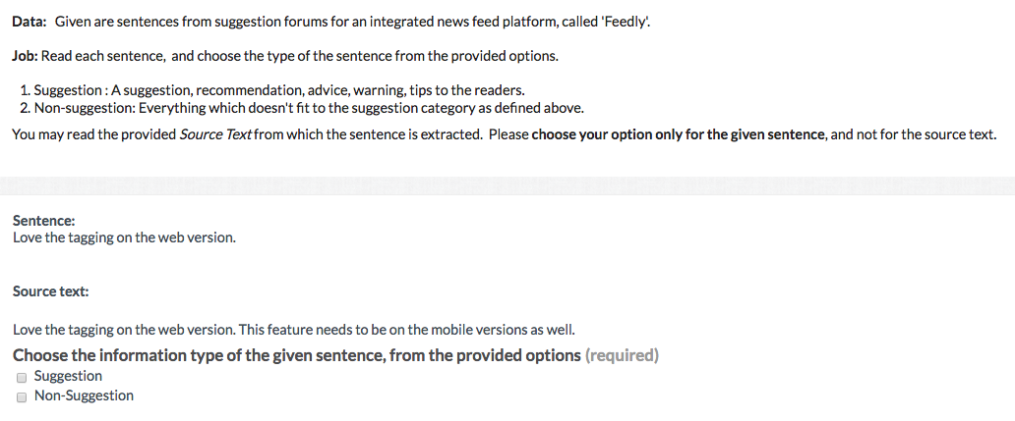
Corpus Annotation - Examples
Zayed, O., 2021. Metaphor Processing in Tweets. PhD Thesis, NUI Galway
Negi, S., 2019. Suggestion mining from text. PhD Thesis, NUI Galway

Slide 60
Text Corpus – Types
Annotated corpus vs. ‘raw data’
General vs. Domain-specific corpus
Monolingual vs. Multilingual corpus
Parallel vs. Comparable multilingual corpus
Multimodal corpus

Slide 61
Annotated Corpus (Labeled Data)
Corpus with annotations on word, phrase, sentence or document level
Syntax/Morphology PoS, phrase structure, parse tree,…
Semantics word senses, terms, entities, relations, …
Other translations, multi-modal references, …
Annotated corpus is used in NLP for supervised training and/or evaluation

Slide 62
General Corpus
Please note
Corpora (datasets) such as Common Crawl will be unbalanced and possibly introduce bias - more on this in the lecture on Ethics in NLP
Representative of a language as a whole
e.g. ‘British English from late twentieth century’
Used for training general purpose NLP tools/models
not tuned to a specific domain
Examples
British National Corpus (BNC) 100 million words (1994)
Corpus of Contemporary American English (COCA) 1 billion words (latest update 2020)
German Reference Corpus 53 billion words (March 2022)
Slovenian Reference Corpus 600 million words (latest update 2006)
Common Crawl (160 languages) 2.55 billion web pages (Aug 2022)
https://commoncrawl.github.io/cc-crawl-statistics/plots/languages

Slide 63
Domain Corpus
Representative of a domain-specific subset of a language
language as used specifically, e.g., in healthcare, finance, legal, …
Used for training domain-specific NLP tools/models, e.g.
healthcare: corpus of medical documents (patient records, clinical notes, …)
https://www.i2b2.org/NLP/DataSets/Main.php
legal: corpus of legal documents (national/international law, legal cases, contracts, …)
https://archive.ics.uci.edu/ml/datasets/Legal+Case+Reports

Slide 64
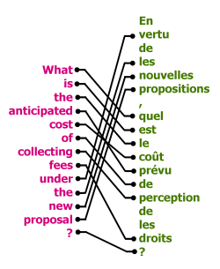
Monolingual vs. Multilingual Corpus
Monolingual Corpus
text (or speech data) in one language
more readily available (easy to find data in one language)
Multilingual Corpus
text (or speech data) in two or more languages
consist of pairs (bilingual) or tuples (multilingual) of translations
mostly used for training machine translation systems
not easily available (difficult to find translated data)

Slide 65
Parallel vs. Comparable Corpus
Parallel Corpus
collection of translated documents, e.g. proceedings of the European Parliament with translations between 21 European languages http://www.statmt.org/europarl/
Comparable Corpus
collection of documents on the same topic in different languages, e.g. links between Wikipedia articles in different languages

Slide 66
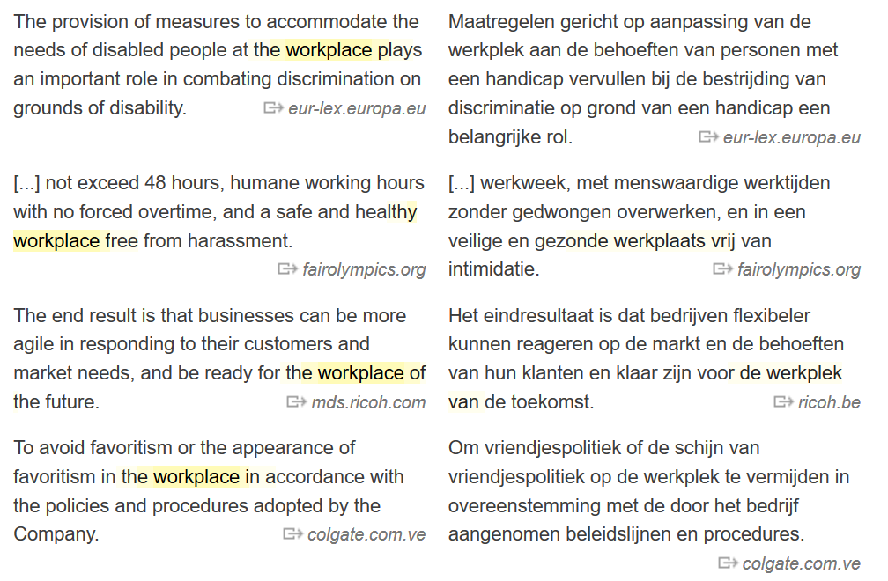

Parallel Corpus – Example
https://www.linguee.com/

Slide 67
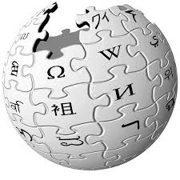
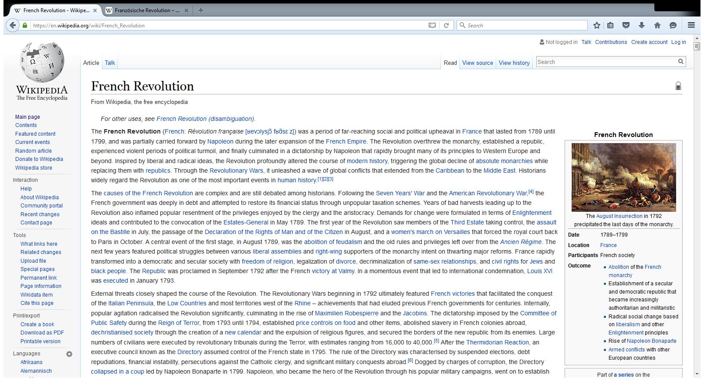
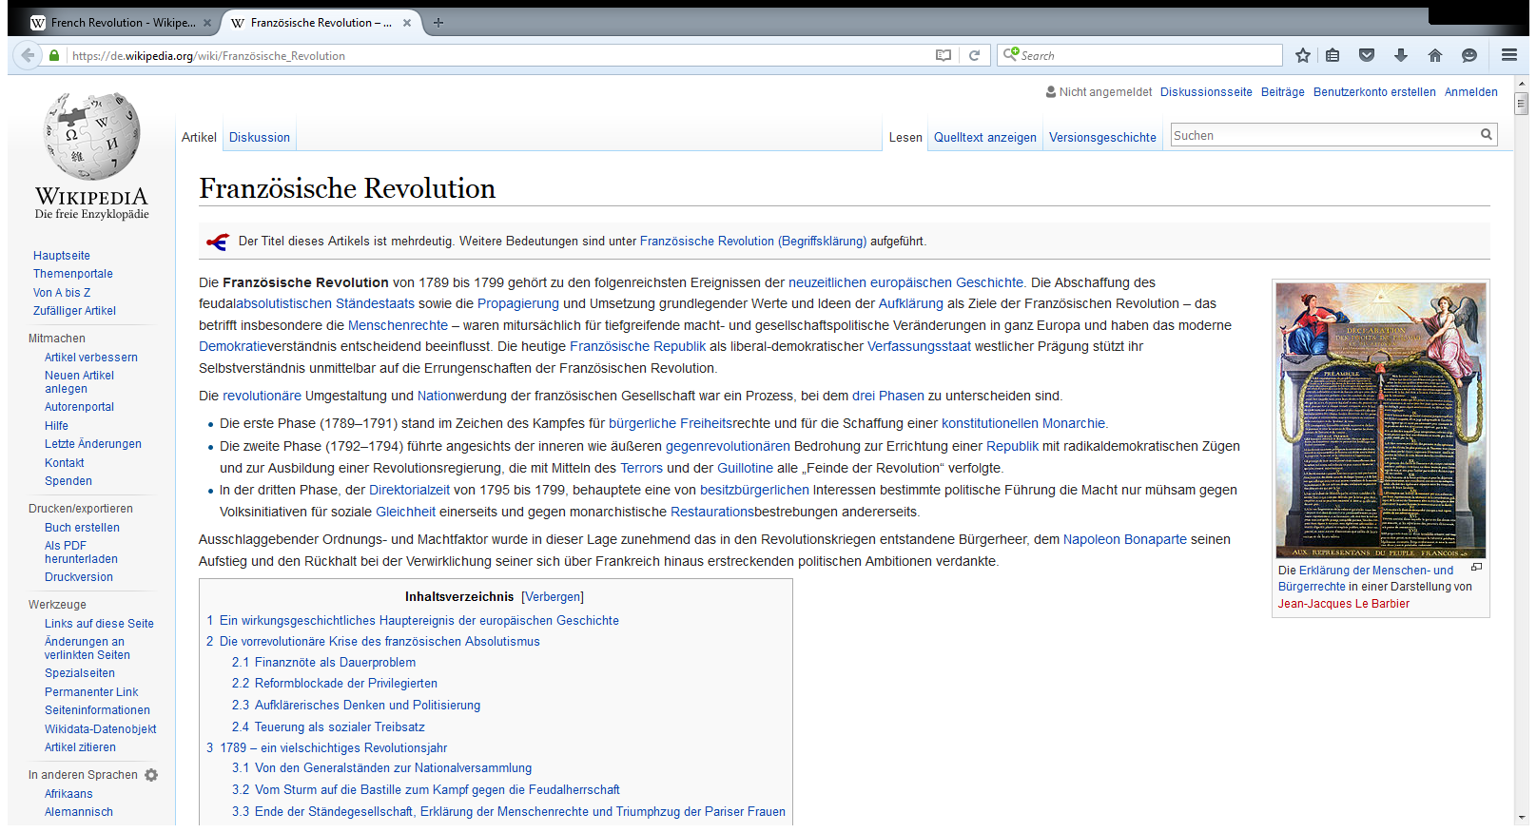
Comparable Corpus – Example
English Wikipedia on French Revolution: Napoleon, war, global view, ….
German Wikipedia on French Revolution: human rights, constitution, …

Slide 68
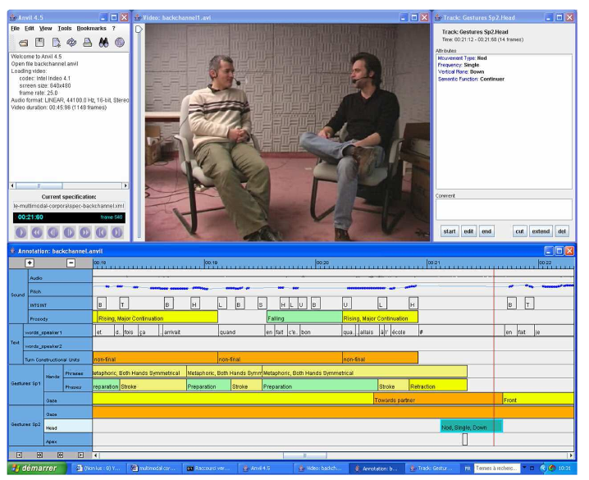
Multimodal Corpus
Consists not only of language data but also image, audio, video, …
Image from Blache et al, 2008. Creating and exploiting multimodal annotated corpora: the ToMA project. In International LREC Workshop on Multimodal Corpora (pp. 38-53). Springer, Berlin, Heidelberg.

Slide 69
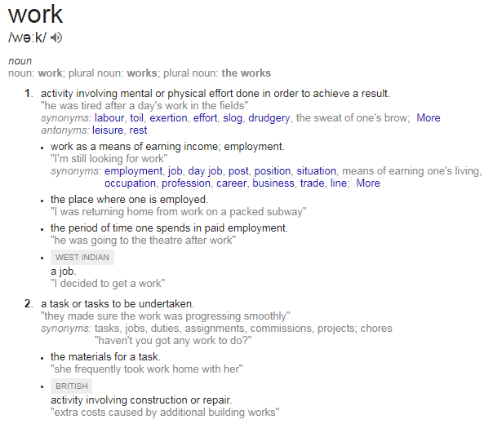
Language Data - Lexicon
Database of words with lexical properties such as spelling, pronunciation, morphology, PoS, semantics, …
Originating out of paper dictionaries

Slide 70


Semantic Lexicon
Organized by ‘synsets’ – represents word meaning by use of sets of Synonyms
https://wordnet.princeton.edu/
Organized by ‘frames’ – represents word meaning by use of Semantic Roles
https://framenet.icsi.berkeley.edu/fndrupal/about

Slide 71
WordNet
Word meaning represented in WordNet by use of “synsets” (Miller, 1995)
For example:
{board, plank} represents ‘board’ in the meaning of ‘plank’
{board, committee} represents ‘board’ in the meaning of ‘committee’
Miller, George A. "WordNet: a lexical database for English." Communications of the ACM 38.11 (1995): 39-41.

Slide 72
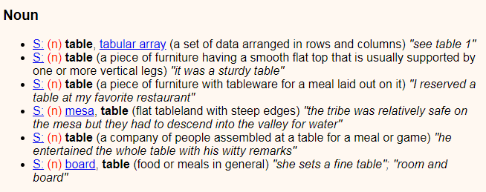
WordNet - Synsets for the Noun table
http://wordnetweb.princeton.edu/perl/webwn

Slide 73
WordNet - Hypernyms & Hyponyms
Synsets are organized hierarchically in WordNet, expressing generalization (hypernyms) and specialization (hyponyms)
{entity}
…
{whole, unit}
{building material}
{lumber, timber}
{board, plank}
hypernym
hyponym

Slide 74
FrameNet
Based on Frame Semantics (Fillmore 1968)
“frame [is] a description of a type of event, relation, or entity and the participants in it”
Frames express Semantic Roles - for example:
cooking typically relates to an Apply_Heat event
involving a person doing the cooking (Cook)
the food that is to be cooked (Food)
something to hold the food while cooking (Container)
and a source of heat (Heating_instrument)
Fillmore, C. J. (1968). The case for case. In Bach, E.W. and Harms, R. T. (Eds.), Universals in Linguistic Theory, p1–88

Slide 75
Frames, Frame Elements & Lexical Units
Frame Apply_Heat
Frame Elements Cook ; Food ; Container ; Heating_Instrument
Lexical Units bake, boil, cook, simmer, steam, …
Note: lexical units within a frame are synonyms

Slide 76
Under-resourced Languages
Non-standard Writing System
Lack of linguistic documentation
Limited presence on the Web
No (large) corpora
No lexicon (dictionary)
NLP applications absent or poor

Slide 77
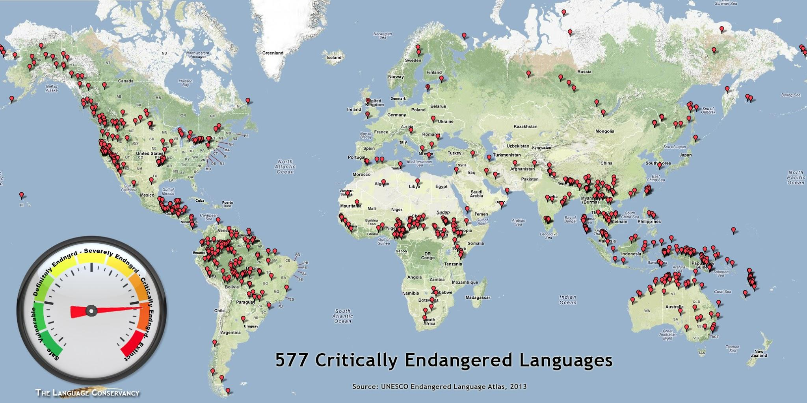

Slide 78
Learning Outcomes
After completing this topic, you should be able to:
Distinguish and understand basic linguistic concepts used in NLP
Understand different levels of linguistic analysis
Understand different types of language data
This lecture is based on parts of:
Chapters 2, 13 and 14 in Jurafsky and Martin, SPEECH and LANGUAGE PROCESSING: An Introduction to Natural Language Processing, Computational Linguistics, and Speech Recognition, 3rd edition: https://web.stanford.edu/~jurafsky/slp3/ed3book.pdf

Slide 79




Lab of this week
Practical application of Linguistic Concepts by use of NLTK (“platform for building Python programs to work with human language data”)

